Slide 1
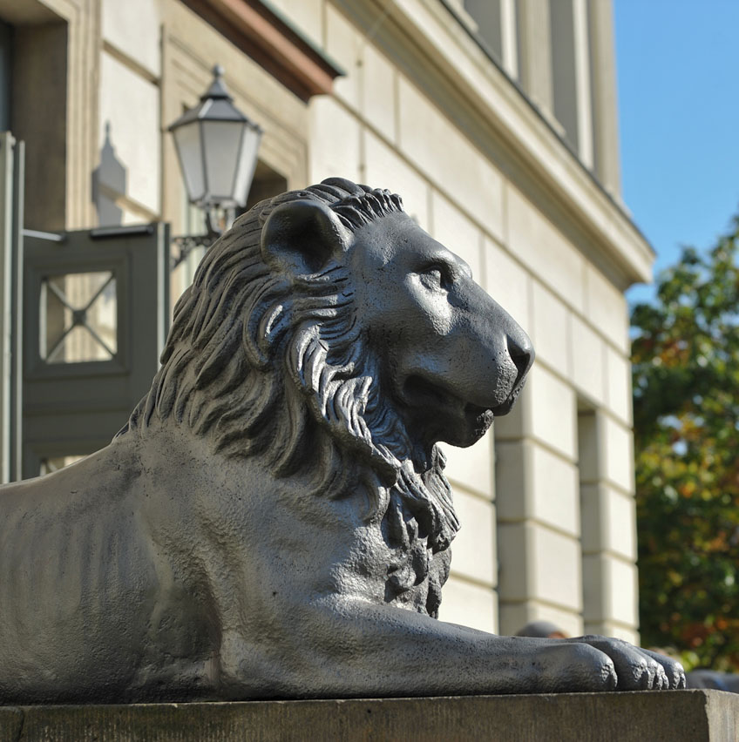
Studying, teaching and researching in Halle – MLU at a glance
Photo: MLU / Markus Scholz

Slide 2
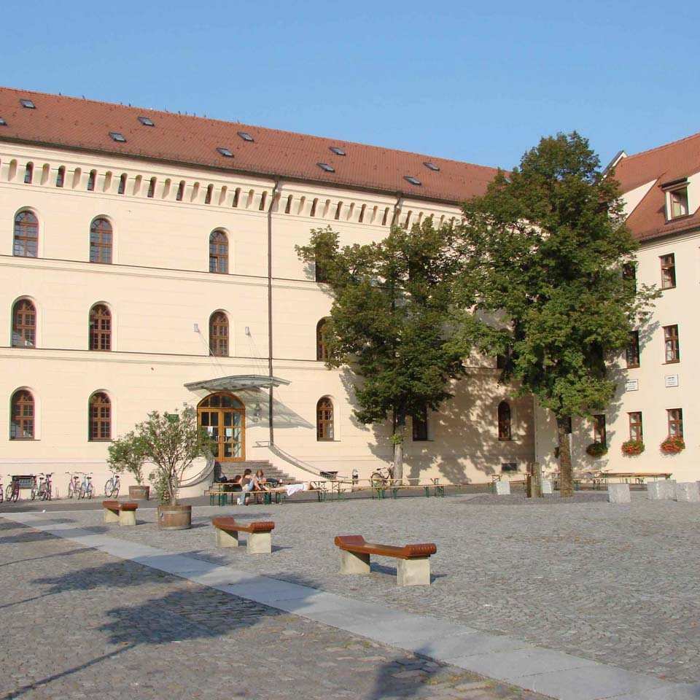
History of the University
University of Wittenberg (1502–1817)
Centre of the Reformation
Site of activities of:
Martin Luther
Philipp Melanchthon
Johannes Bugenhagen
Photo: WIKIPEDIA / Torsten Schleese

Slide 3
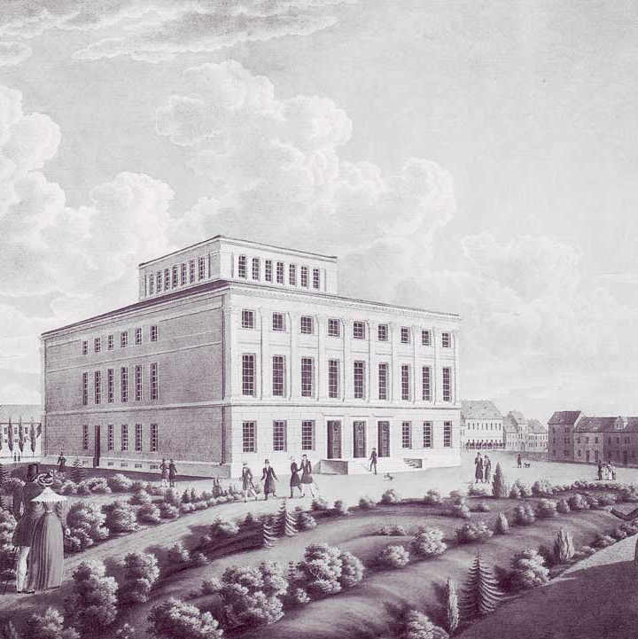
History of the University
University of Halle (1694–1817)
Centre of the Enlightenment and Pietism
Site of activities of:
August Hermann Francke
Christian Thomasius
Christian Wolff
University building in Halle (1836)

Slide 4
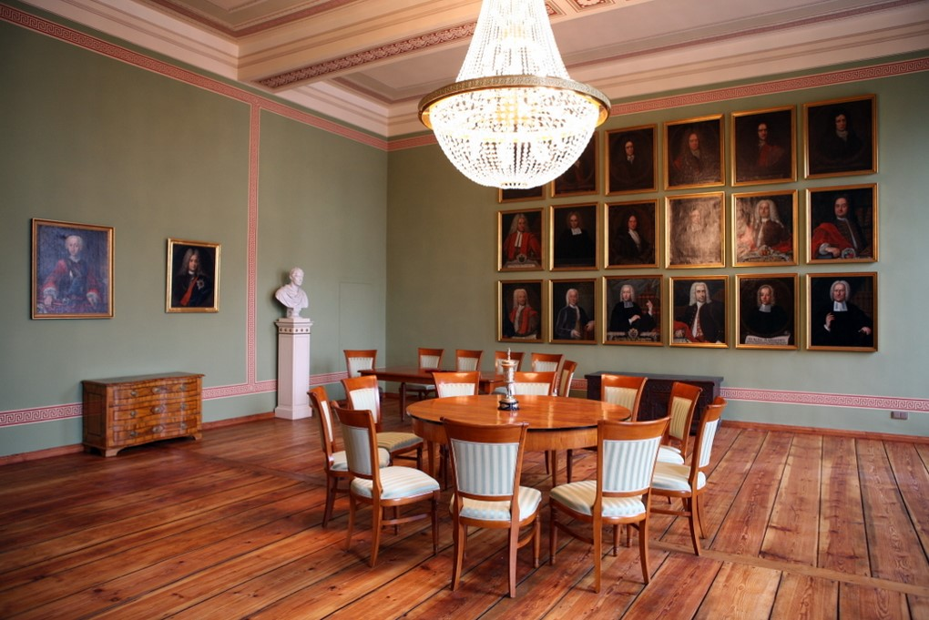
The merging of two universities
The turmoil of the Napoleonic wars brought teaching in Wittenberg and Halle to a standstill. In 1817, the two universities merged and reopened as the United Friedrichs University of Halle-Wittenberg, located in Halle.
Photo: MLU / Simone Friese

Slide 5
Famous MLU Alumni
Anton Wilhelm Amo
First African student to attend a German university (enrolled as a student of philosophy in 1730)
Dorothea von Erxleben
First woman to receive a doctorate from a German university (1754 in medicine)
Georg Cantor
Founder of set theory (1874)
Frederick Muhlenberg
First speaker of the U.S. House of Representatives (1793)
Hans-Dietrich Genscher
Foreign Secretary of the Federal Republic of Germany (1974–1992), studied law at MLU
Karl Ziegler
Nobel laureate in chemistry (1963)

Slide 6
Nine Faculties
Faculty of Theology
Faculty of Law, Economics and Business
Faculty of Medicine
Faculty of Philosophy I – Social and Cultural Studies
Faculty of Philosophy II – Ancient and Modern Languages, Communication Studies, Music
Faculty of Philosophy III – Educational Studies
Faculty of Natural Sciences I – Biological Science
Faculty of Natural Sciences II – Chemistry, Physics and Mathematics
Faculty of Natural Sciences III – Agricultural and Nutritional Sciences, Geography and Computer Science

Slide 7
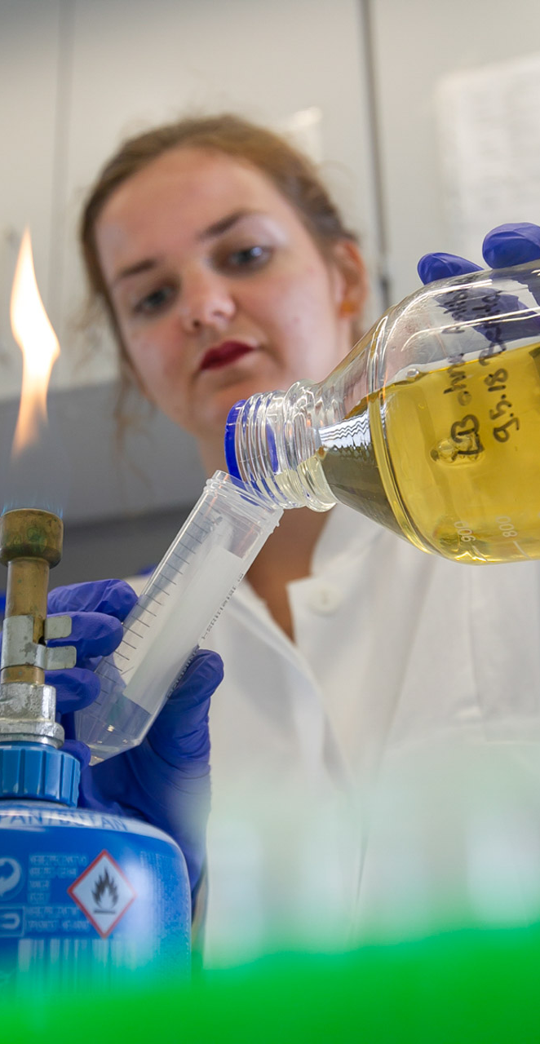
Current Figures
Total enrollment: 20,096
International students: 1,723
Professorships: 363
Assistant professors: 14
Degree courses: 259
State subsidies for research and education in 2019:
University: € 155.8 M
Faculty of Medicine: € 60.2 M
Photo: MLU / Maike Glöckner

Slide 8
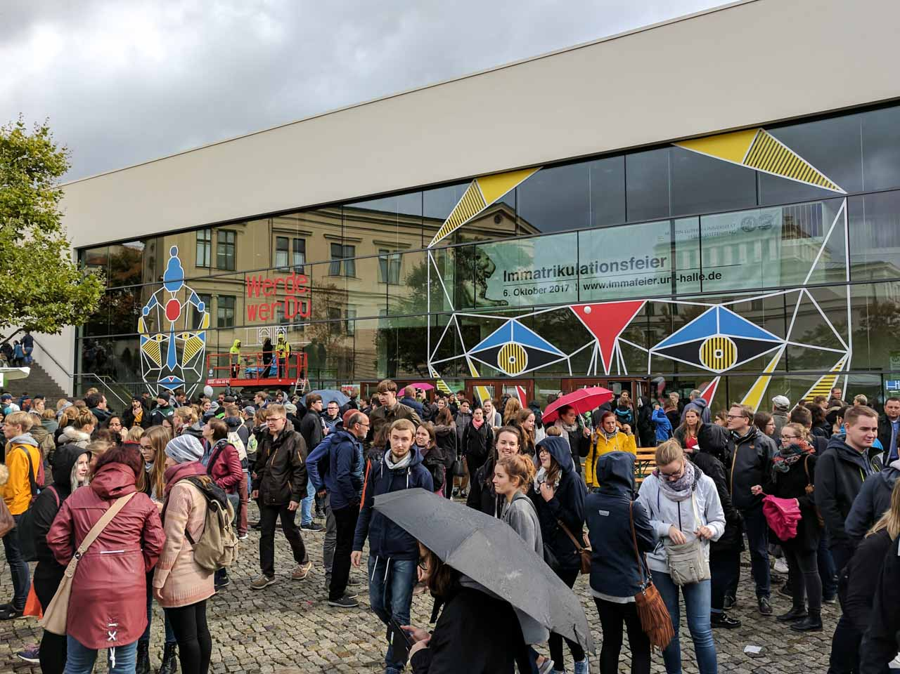
University Square
The main building of the University of Halle is situated on University Square in the heart of the city. Lecture buildings are also located here, such as the Melanchthonianum and the Auditorium Maximum.
Photo: MLU / Katharina Nitschke

Slide 9
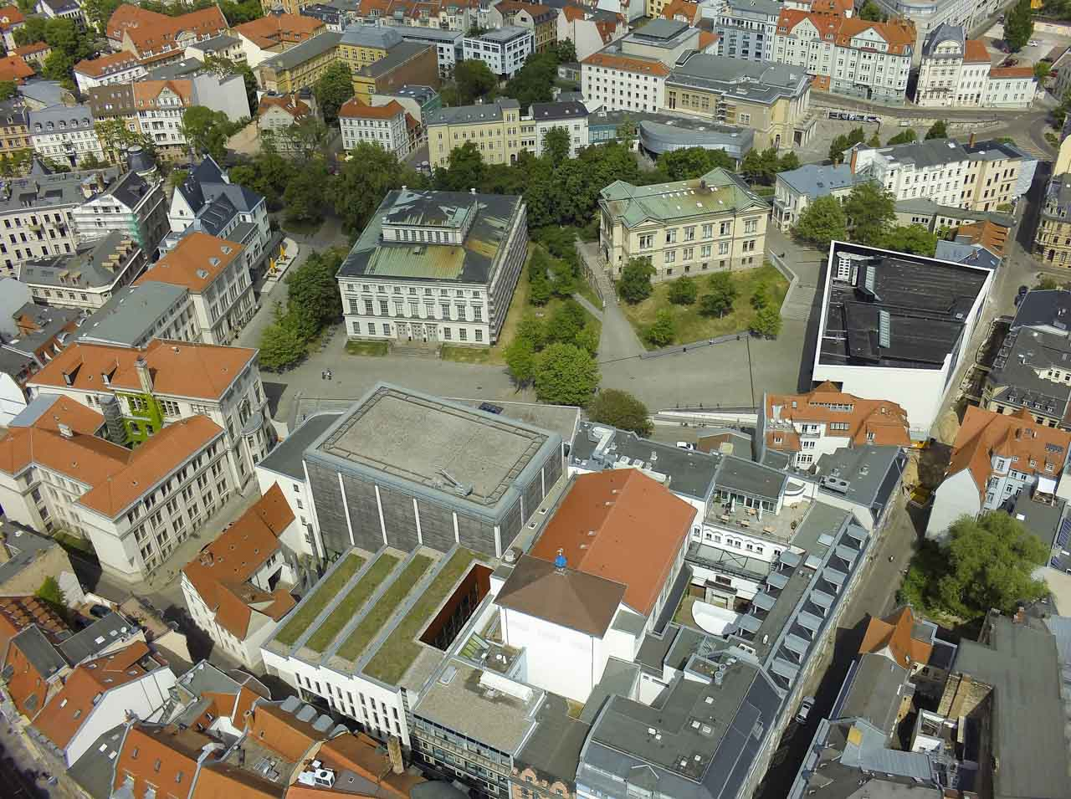
University Square
The main building of the University of Halle is situated on University Square in the heart of the city. Lecture buildings are also located here, such as the Melanchthonianum and the Auditorium Maximum.
Photo: MLU / Maike Glöckner

Slide 10
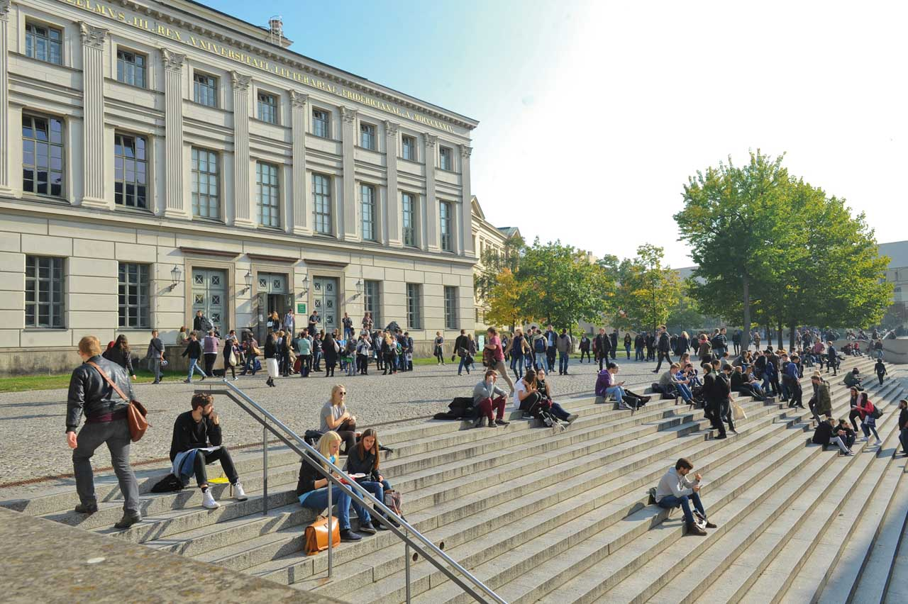
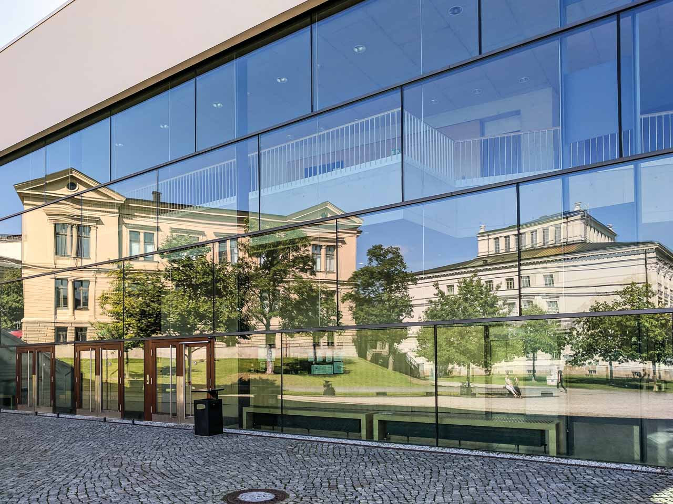
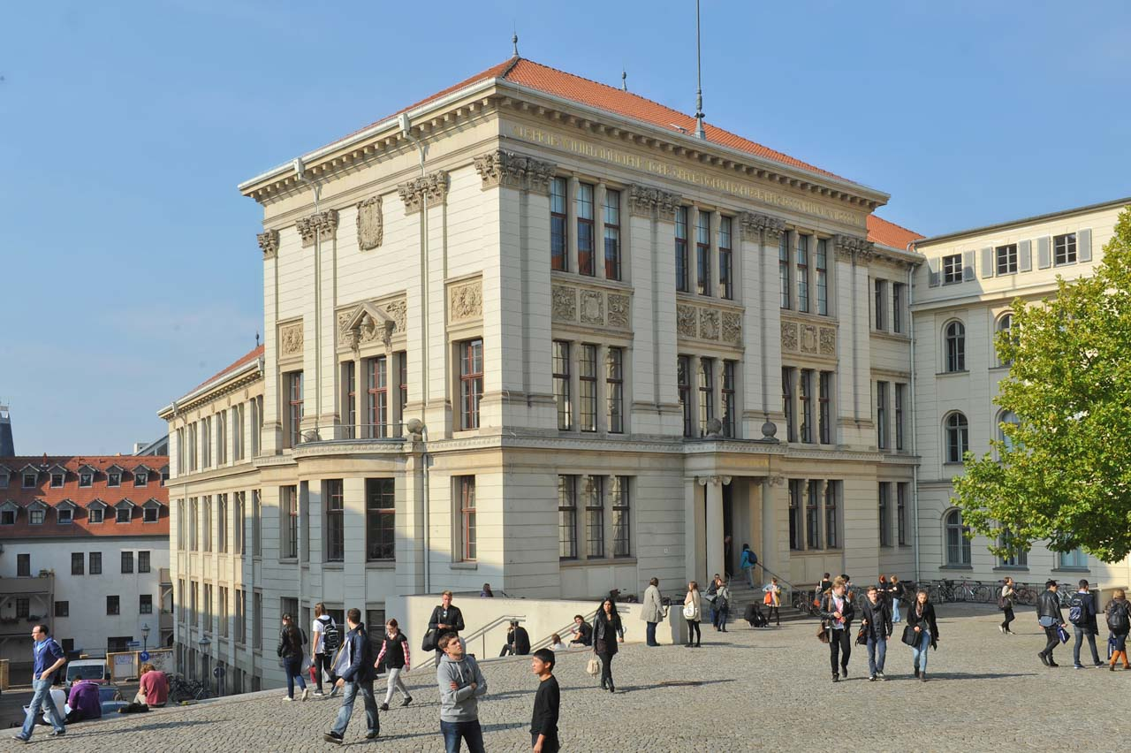
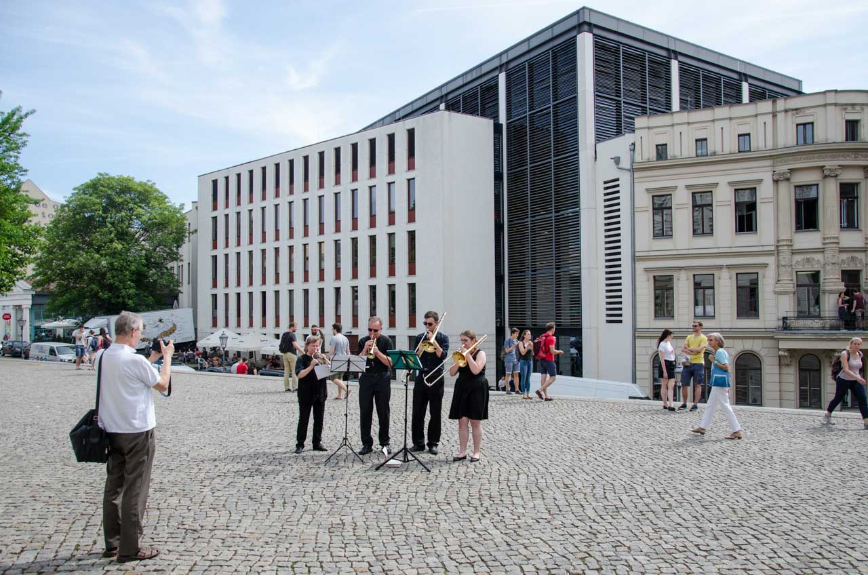
University Square
Photo: MLU / Markus Scholz
Photo: MLU / Katharina Nitschke
The main building of the University of Halle is situated on University Square in the heart of the city. Lecture buildings are also located here, such as the Auditorium Maximum, Robertinum, Juridicum and Melanchthonianum.
Photo: MLU / Katharina Nitschke
Photo: MLU / Markus Scholz

Slide 11
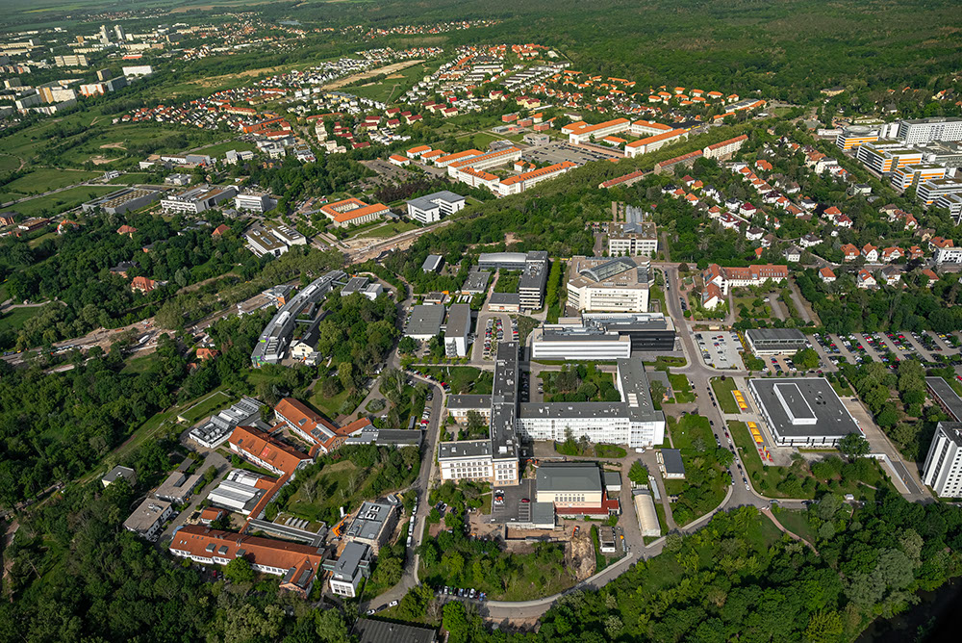
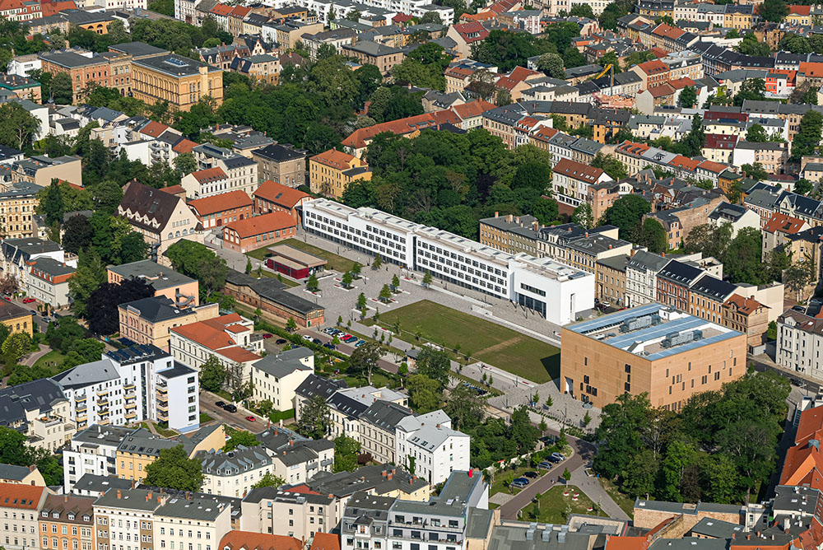
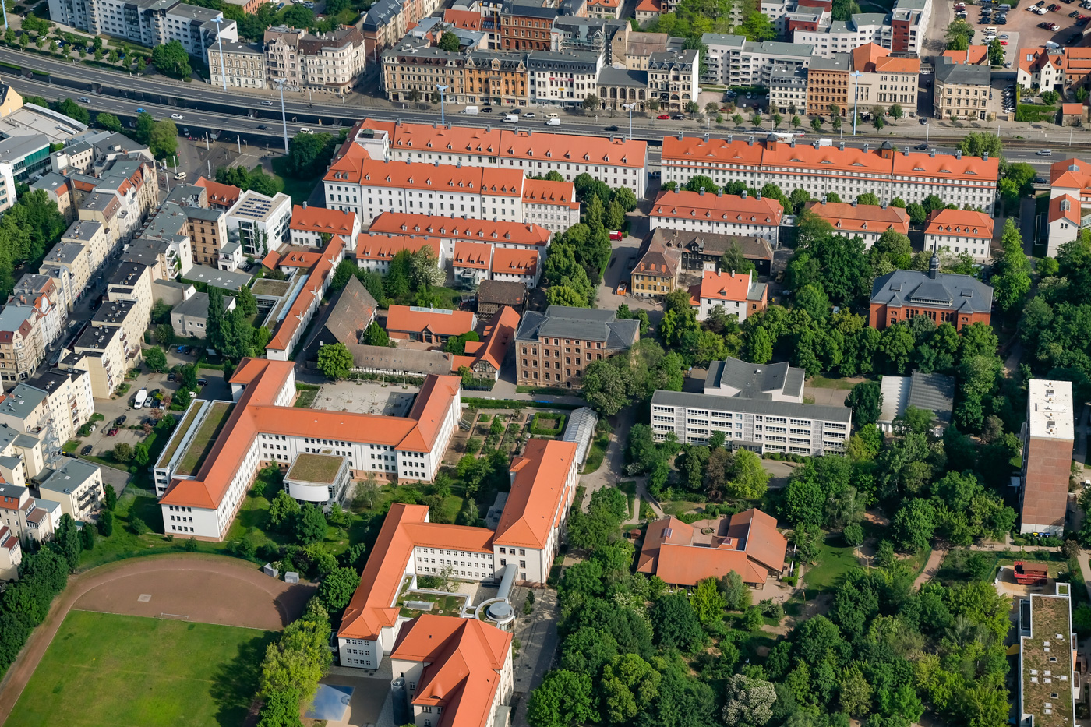
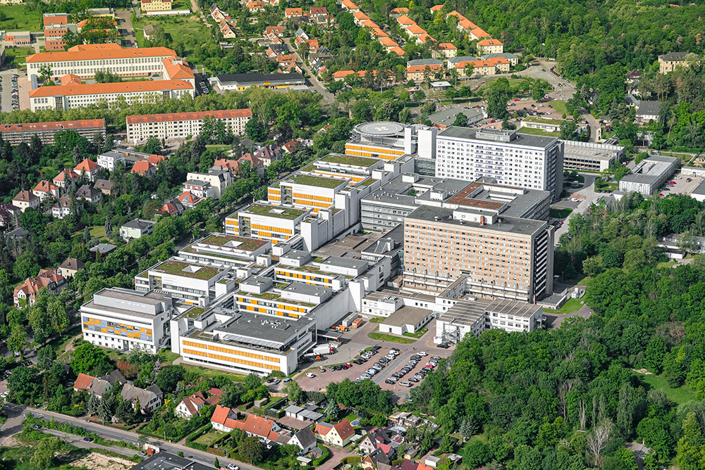
Campuses
Photo: MLU / Maike Glöckner
Photo: MLU / Maike Glöckner
In addition to University Square, other campuses located in Halle include:
Weinberg Campus (with Heide-Süd area)
Steintor Campus
Francke Foundations
Plus: University Hospital
Photo: MLU / Maike Glöckner
Photo: MLU / Maike Glöckner

Slide 12
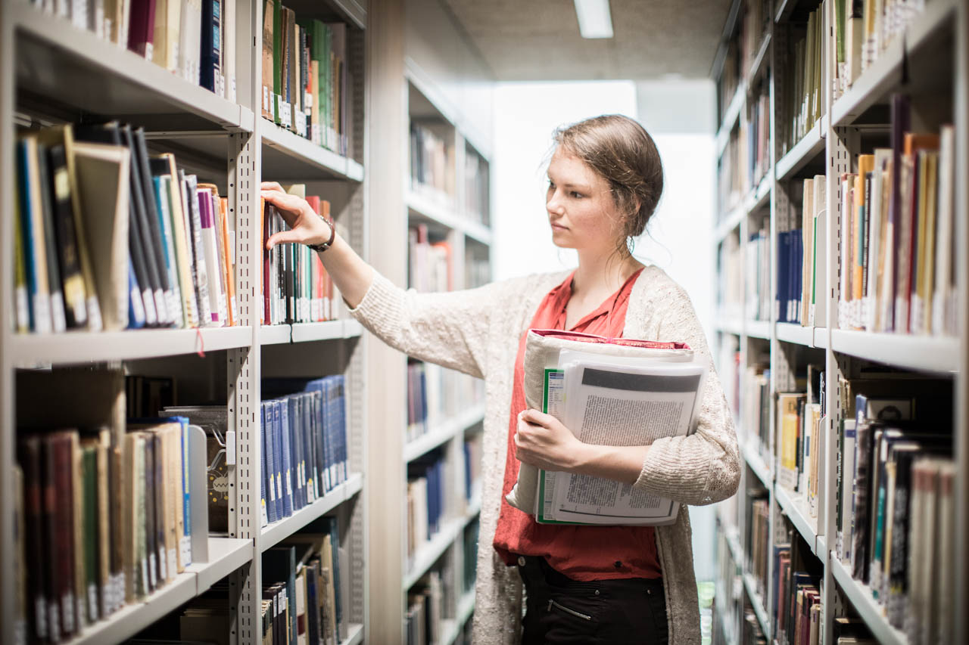
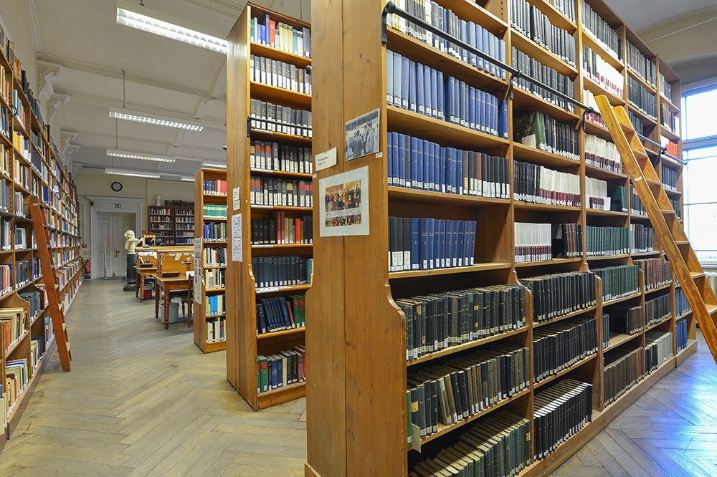
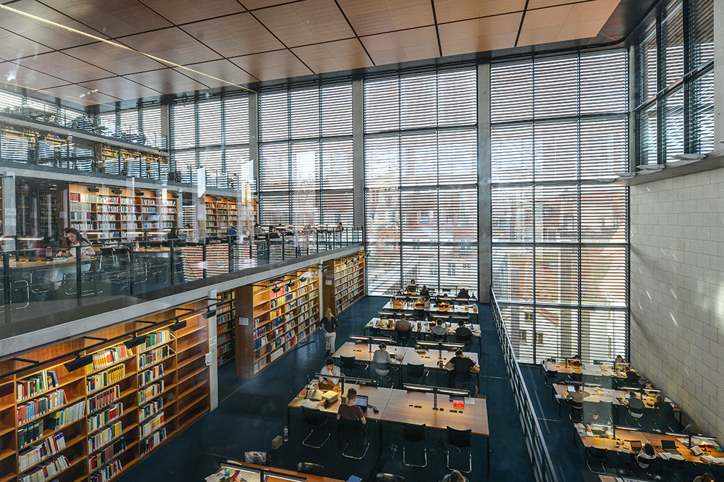
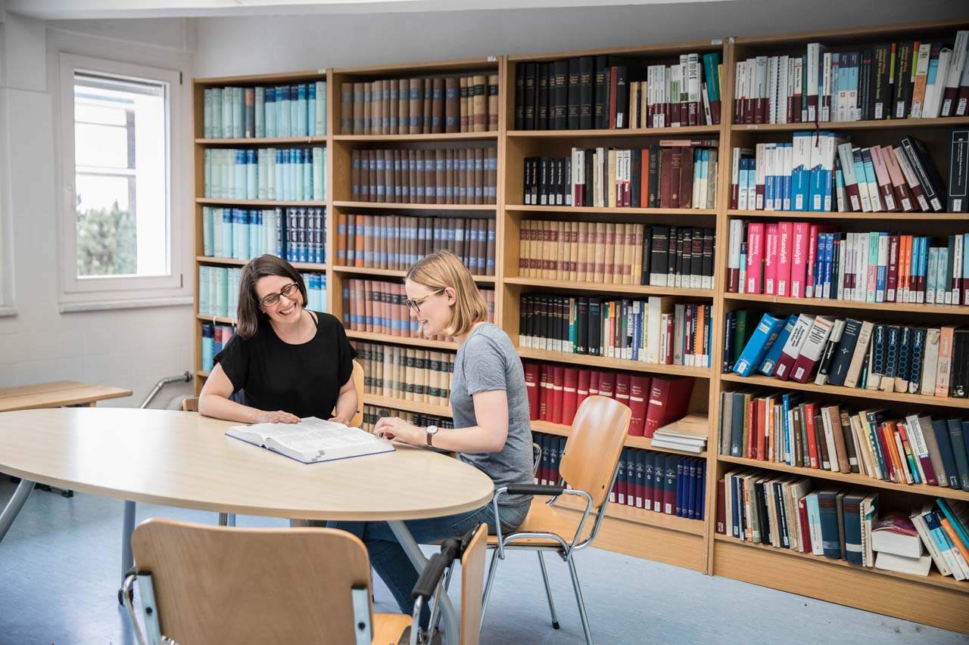
Libraries
Photo: MLU / Matthias Ritzmann
Photo: MLU / Markus Scholz
The University and State Library is the largest scientific library in Saxony-Anhalt. Its catalogue comprises over 5.55 million items housed at the Central Library and in 13 branch libraries.
Photo: MLU / Markus Scholz
Photo: MLU / Matthias Ritzmann

Slide 13
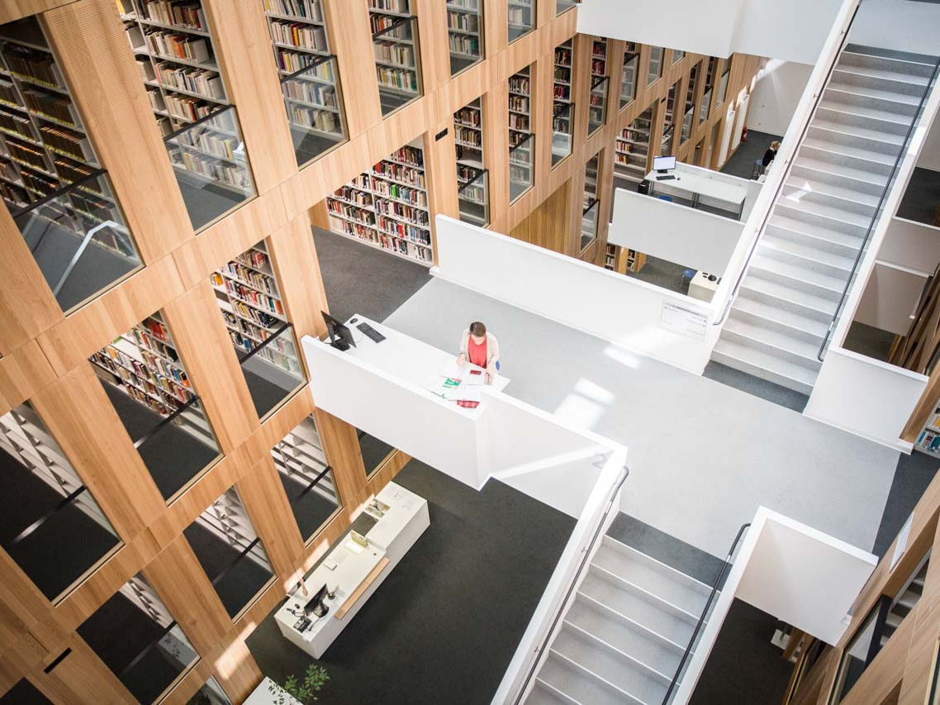
A branch library on the modern Steintor Campus
Photo: MLU / Matthias Ritzmann

Slide 14
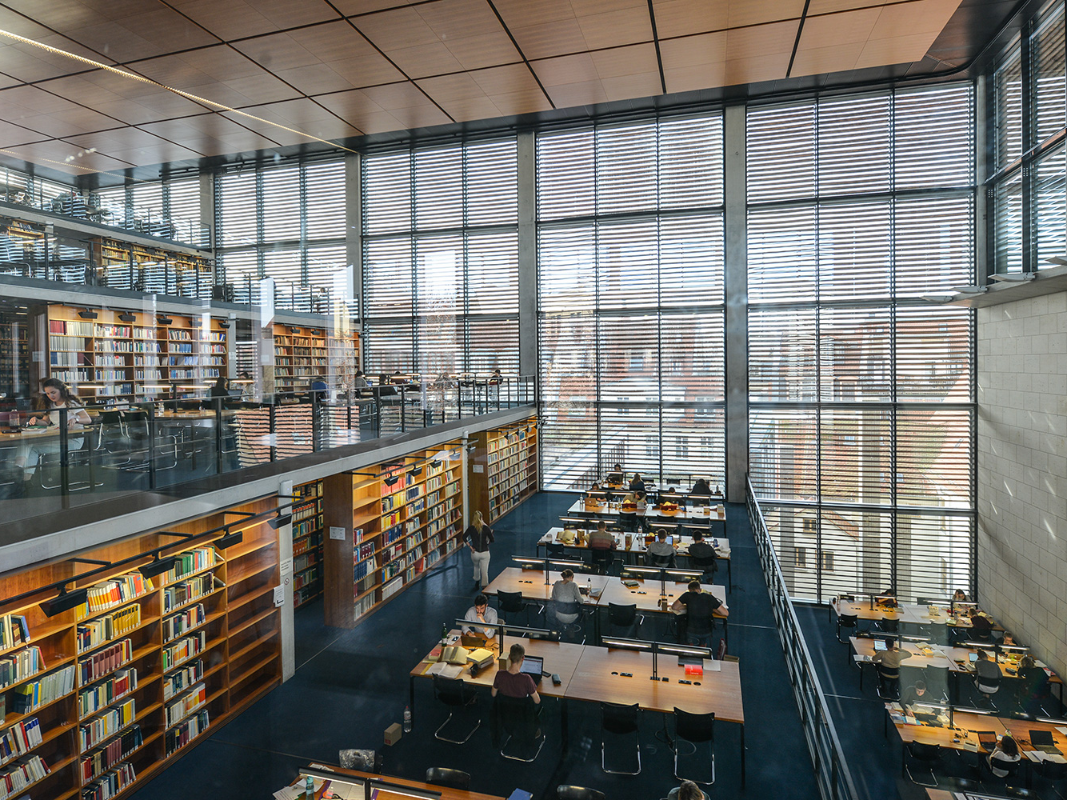
A branch library in the Juridicum on University Square
Photo: MLU / Markus Scholz

Slide 15
Photo: MLU / Markus Scholz

Slide 16
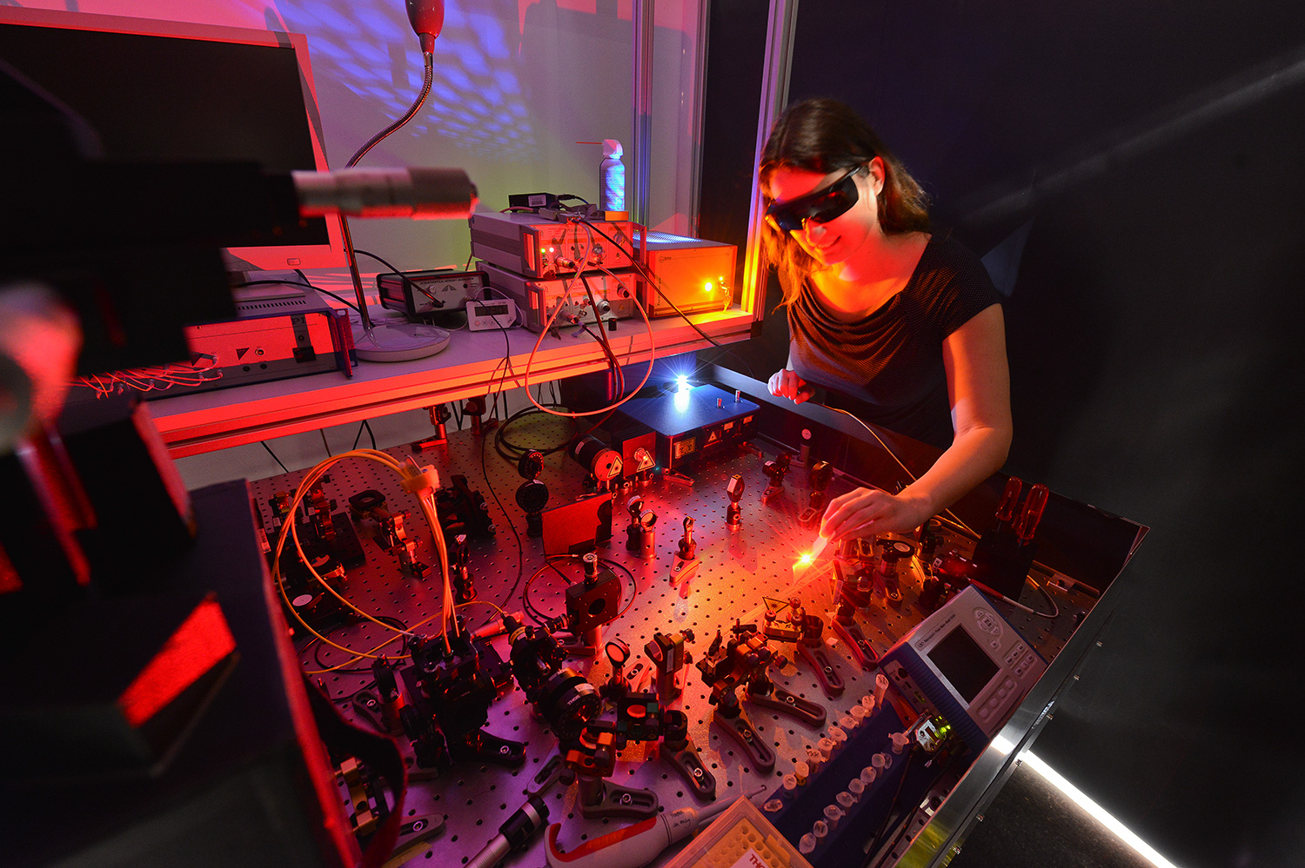
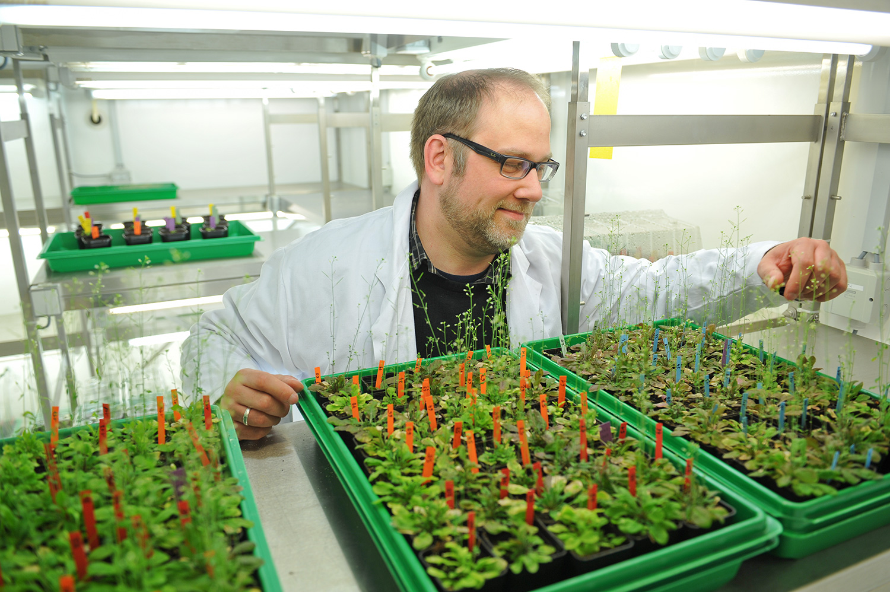
Cutting-edge research at MLU
Photo: MLU / Markus Scholz
Photo: MLU / Markus Scholz

Slide 17
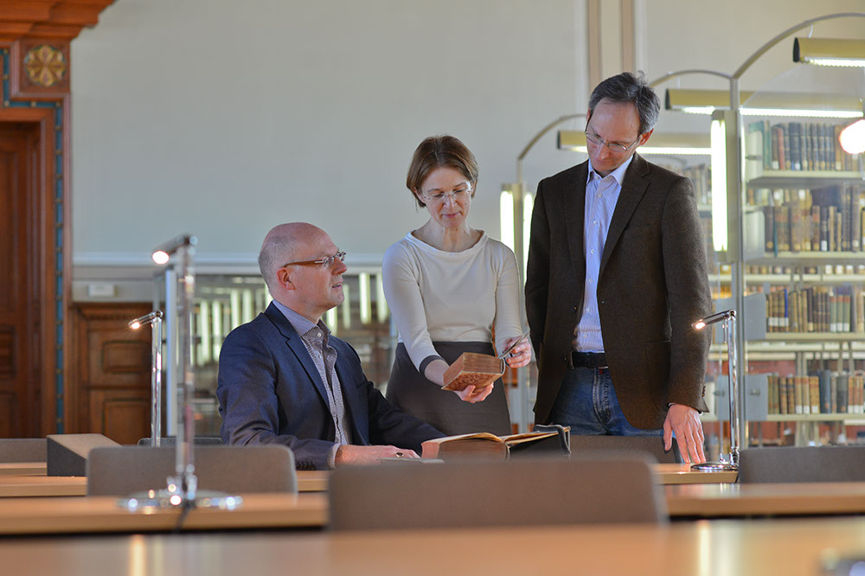
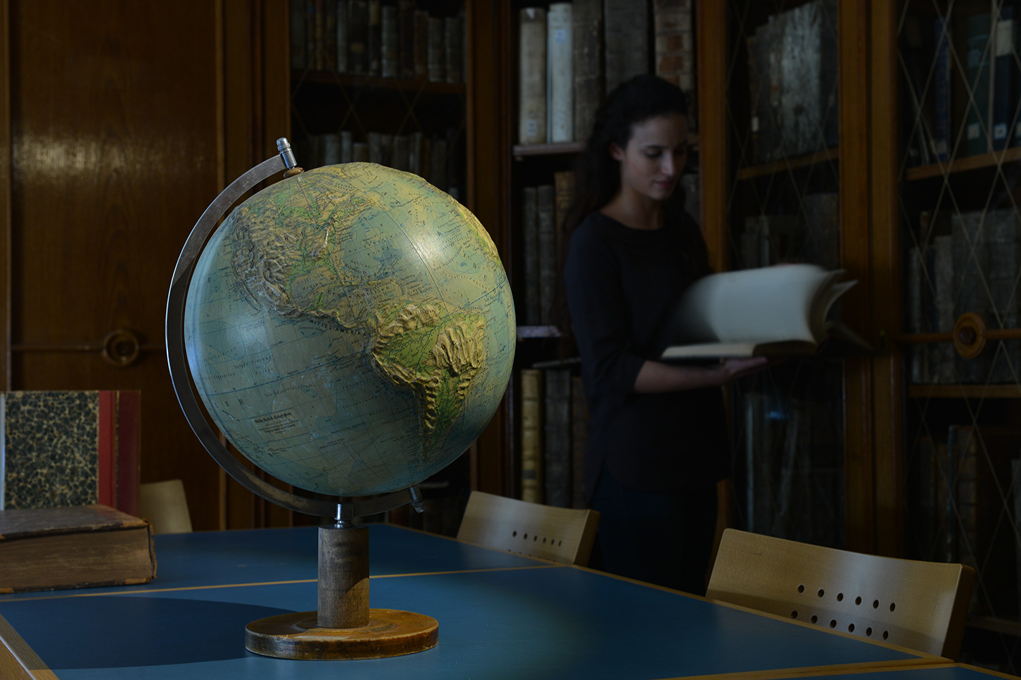
Cutting-edge research at MLU
Material sciences – nanostructured materials
Biological sciences – structures and mechanisms of biological information processing
Enlightenment – religion – knowledge
Society and culture in motion
Photo: MLU / Michael Deutsch
Photo: MLU / Maike Glöckner
Photo: MLU / Maike Glöckner
Photo: MLU / Markus Scholz

Slide 18
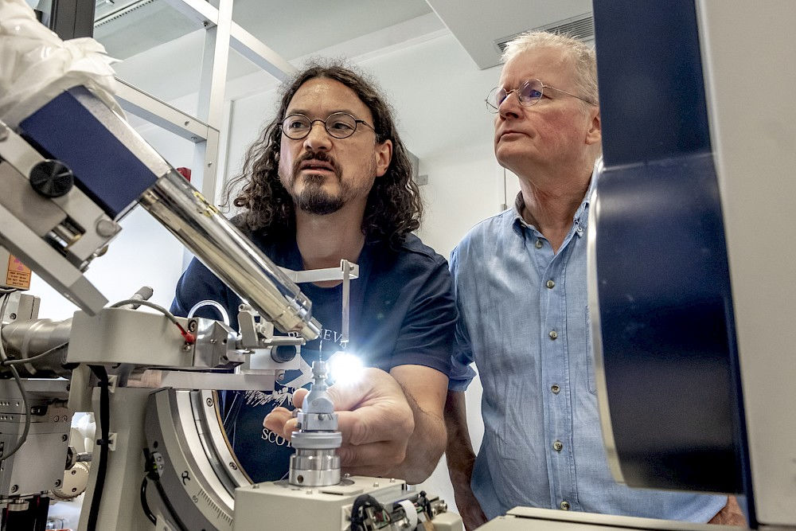
Charles Tanford Protein Centre
The University’s Protein Centre opened in 2018. Here 255 employees conduct joint research on the building blocks of life.
Photo: Milton Stubbs (l) and Elmar Wahle at the Protein Centre
Photo: MLU / Maike Glöckner

Slide 19
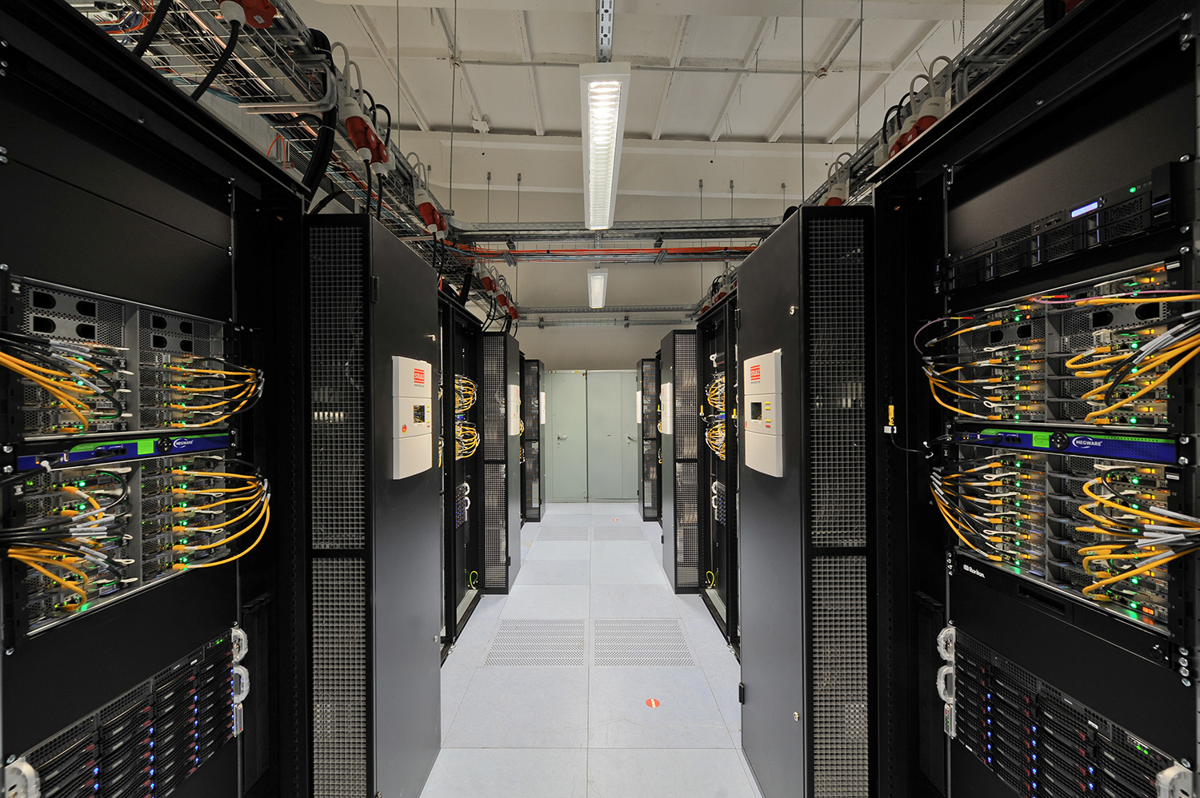
High performance
The university is home to the high-performance computer Janus.
Photo: MLU / Markus Scholz

Slide 20
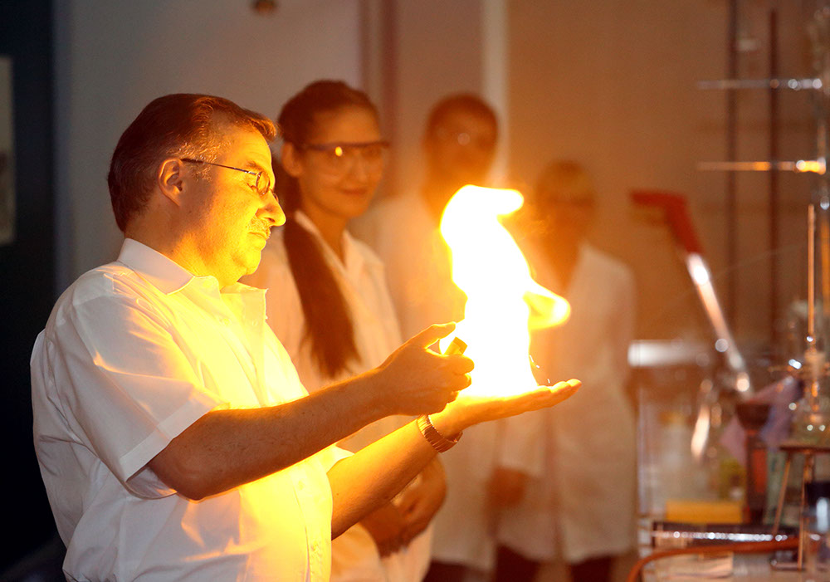
Hands-on science
Photo: MLU / Maike Glöckner

Slide 21
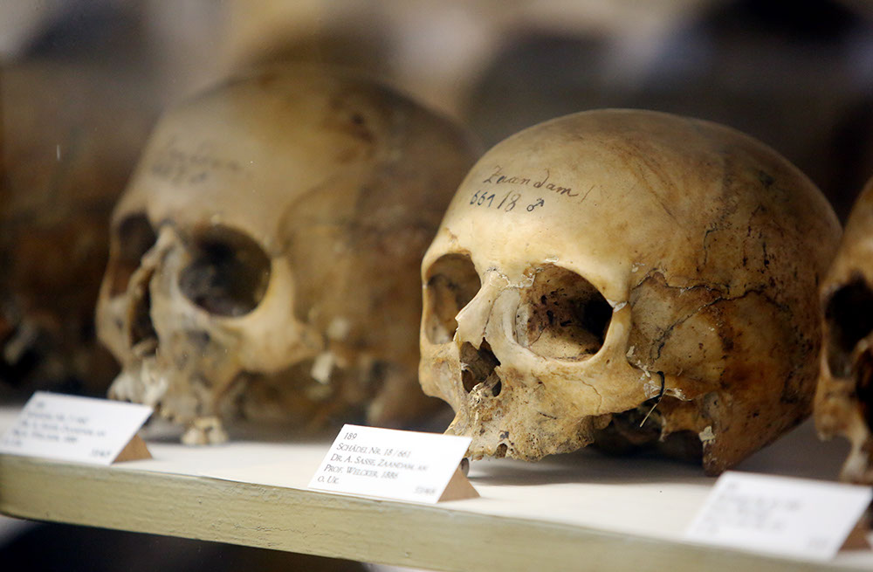
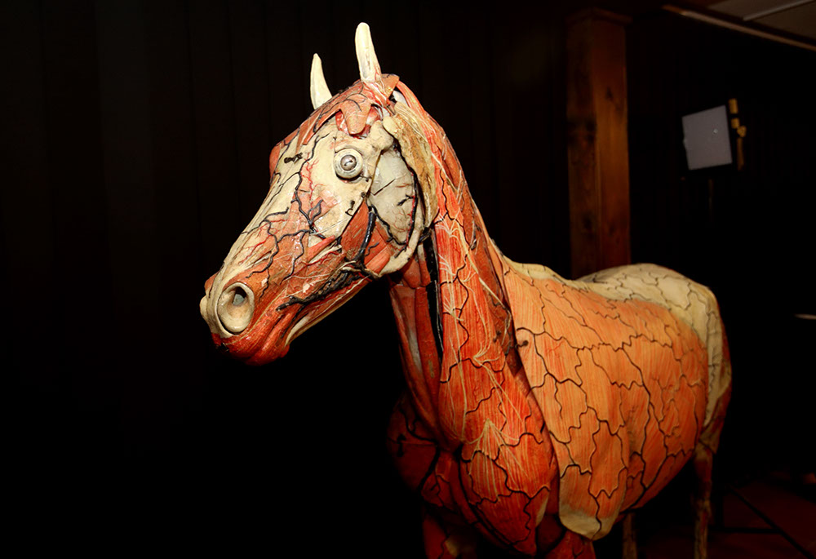
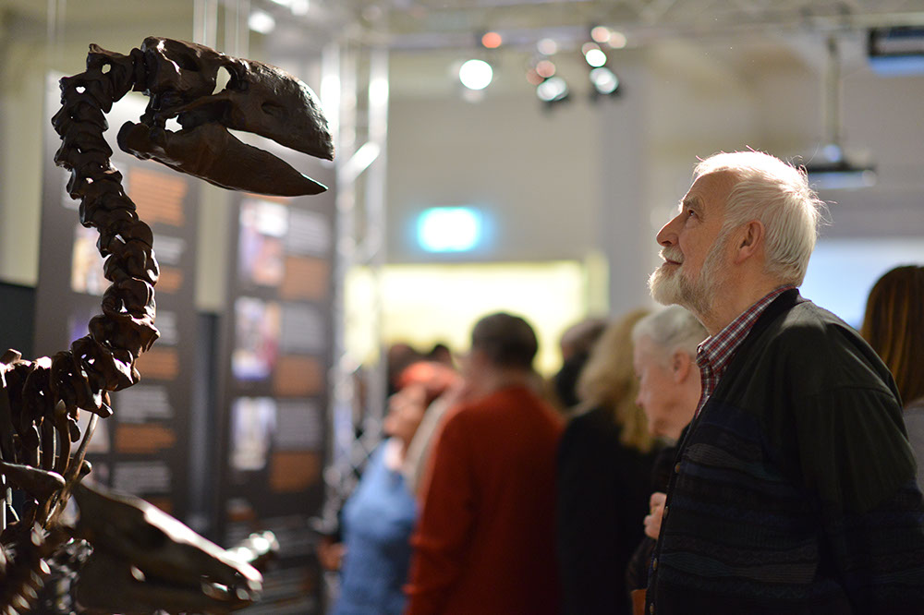
Hands-on science
Photo: MLU / Maike Glöckner
Photo: MLU / Maike Glöckner
Long Night of the Sciences
One-of-a-kind teaching collections totalling 6 million objects
Very valuable: the Meckel Collection and the Zoological Collection
Photo: MLU / Maike Glöckner
Photo: MLU / Markus Scholz

Slide 22
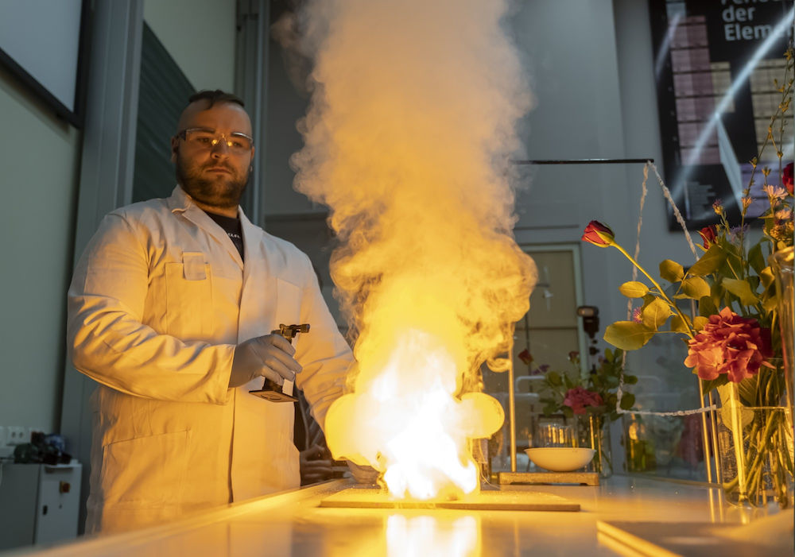
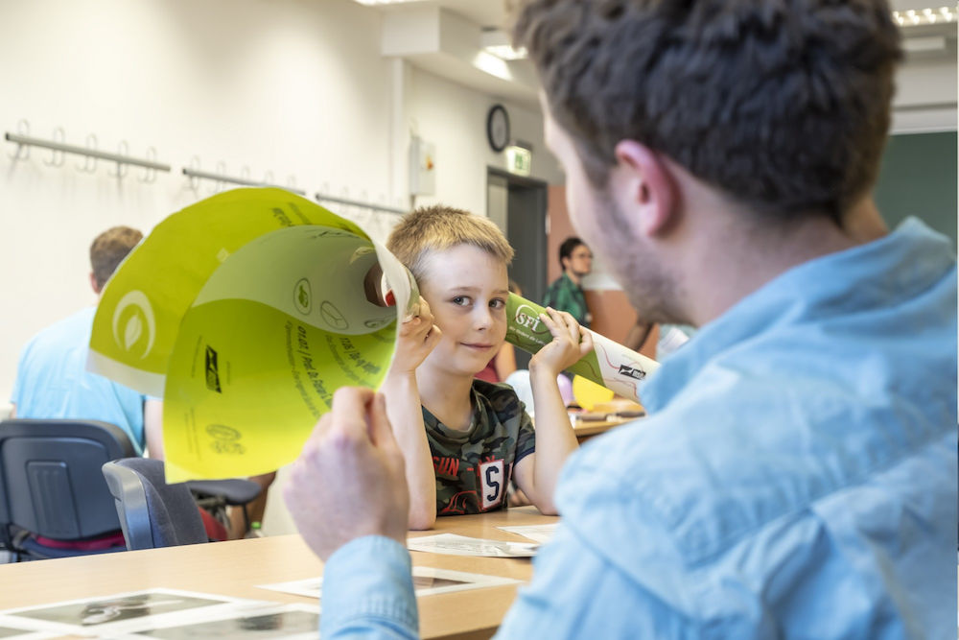
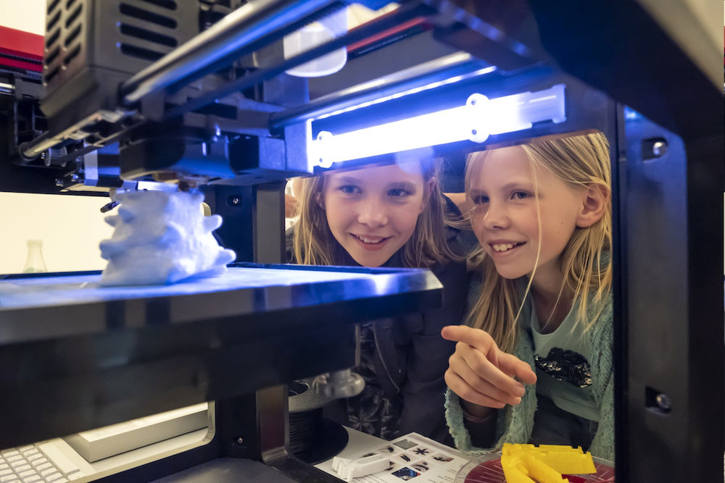
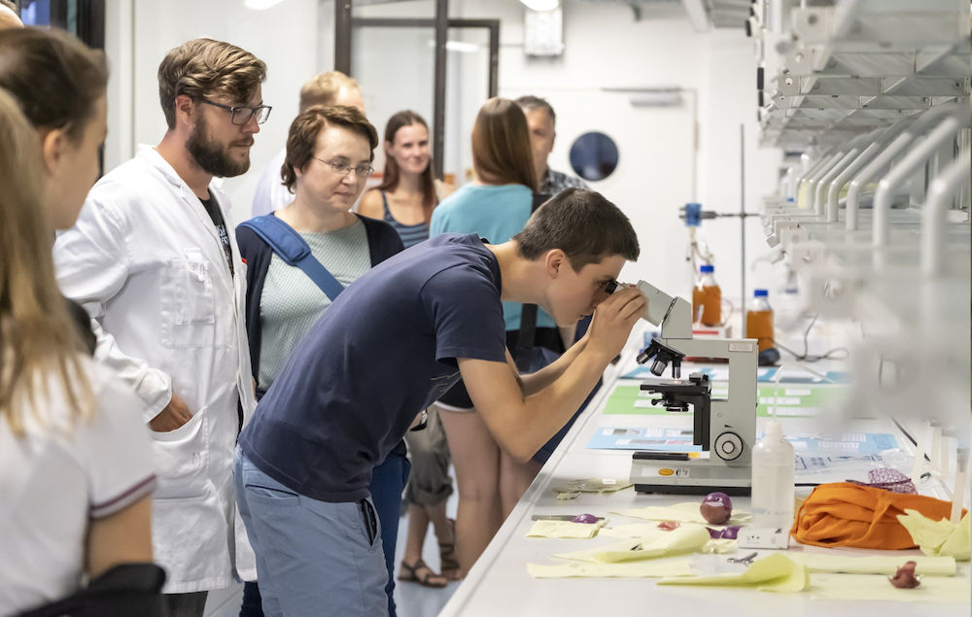
The Long Night of the Sciences
Photo: MLU / Maike Glöckner
Photo: MLU / Maike Glöckner
around 370 events
held at around 80 university and non-university institutions
many experiments, tours and lectures
always on the first Friday in July
Photo: MLU / Maike Glöckner
Photo: MLU / Maike Glöckner

Slide 23
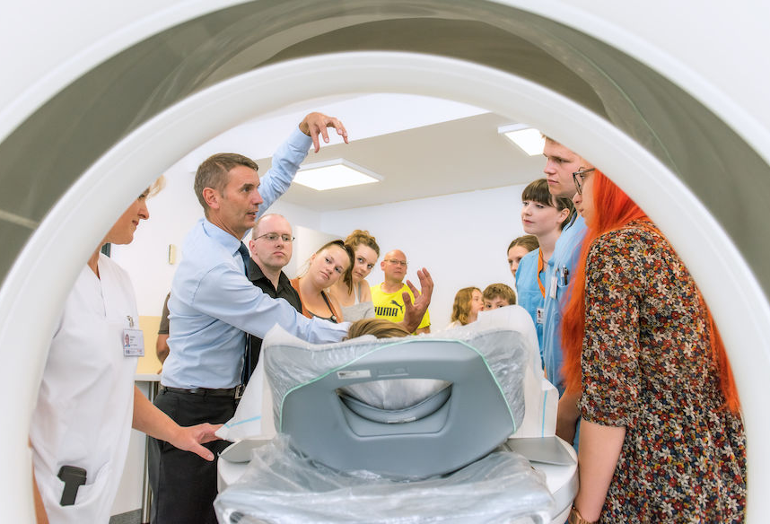
The Long Night of the Sciences
Every year on the first Friday in July, guided tours, experiments and lectures are held at over 80 university and non-university institutions. Here you have the opportunity to take a sneak peak behind the scenes.
Photo: MLU / Fotostelle UKH

Slide 24

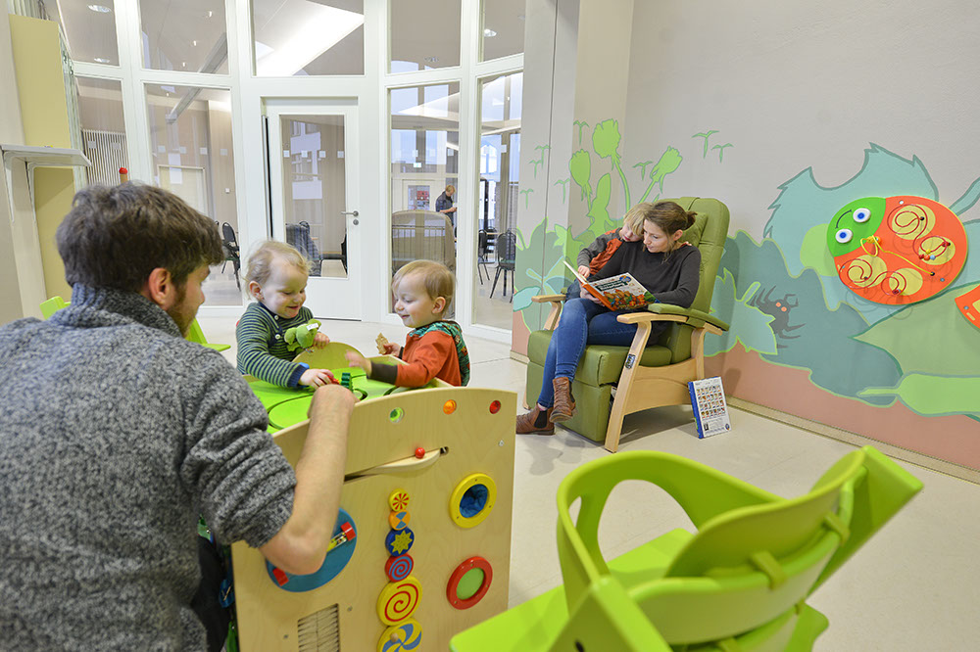
Family-Friendly University
Holder of the “Family-Friendly University Audit” certificate since 2009 for family-friendly work and study conditions
“Weinberg Kids” for short-term and wraparound childcare
Combining caring for family members with studies or career
Photo: MLU / Markus Scholz

Slide 25

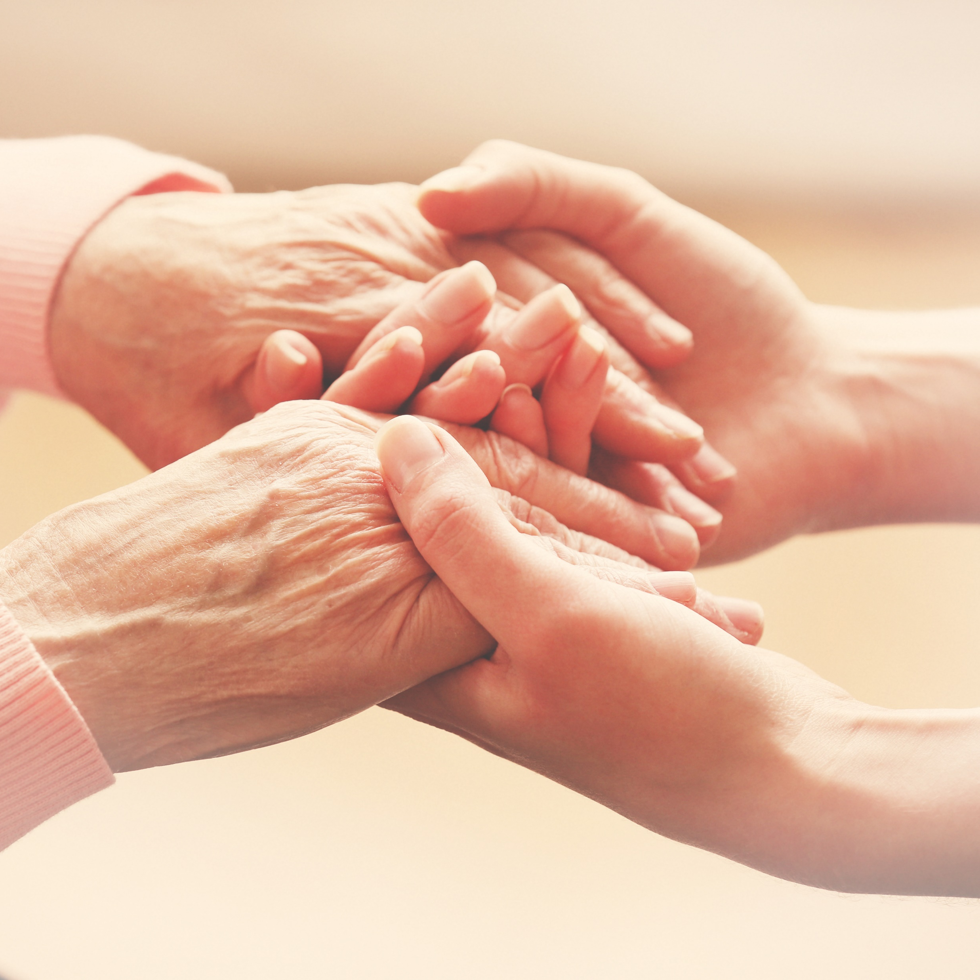
Family-Friendly University
“Family-Friendly University Audit” certificate since 2009 for conditions conducive to working and studying
Zertifikat
“Weinberg Kids” for short-term and wraparound childcare
Combining caring for family members with studies or career
Photo: MLU / Markus Scholz
Photo: stock.adobe.com, Africa Studio

Slide 26
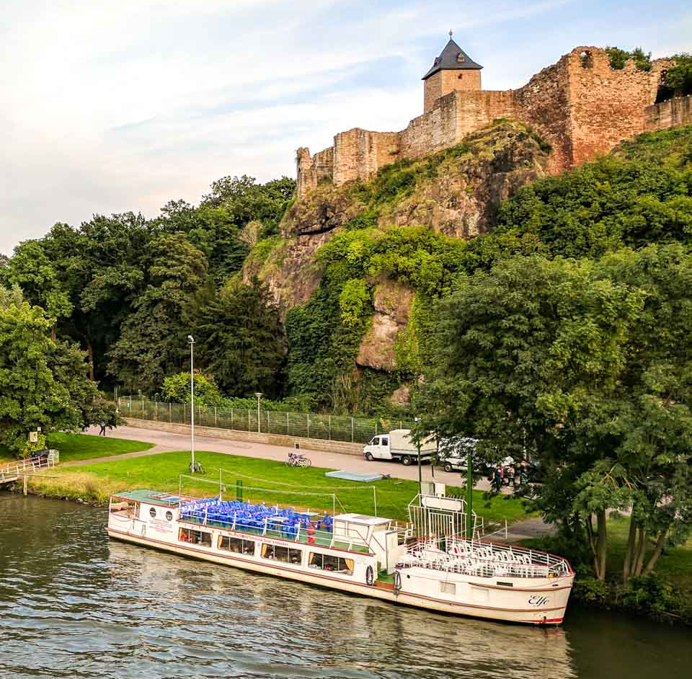
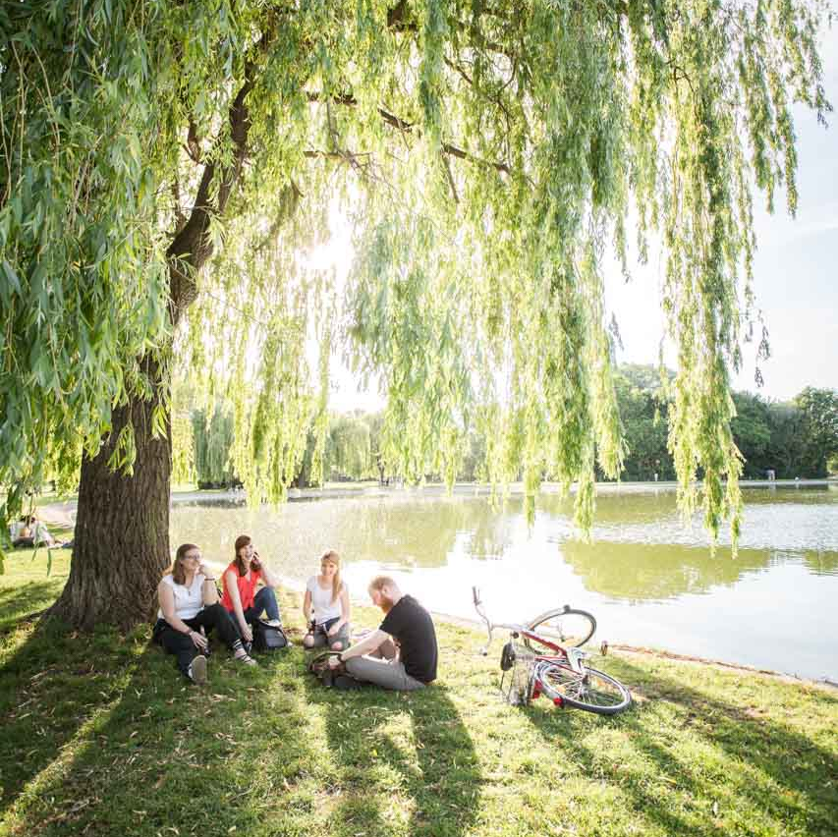
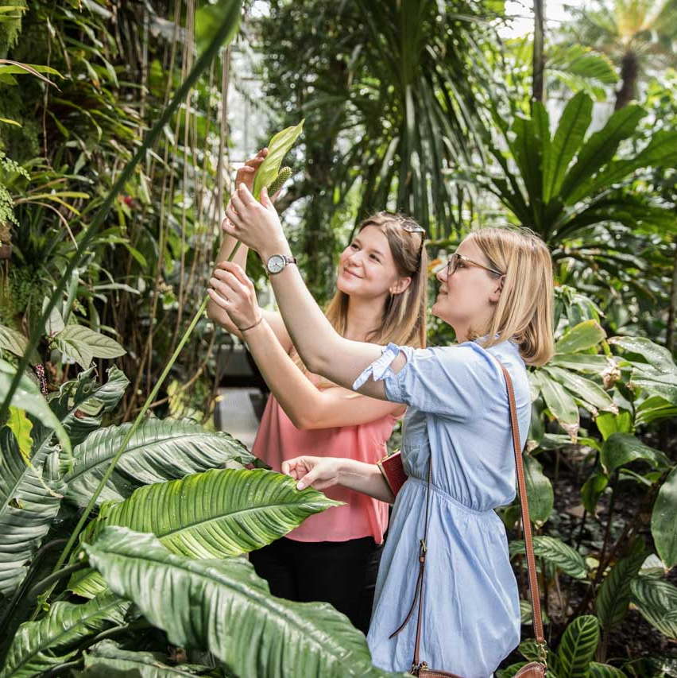
Green Halle
Giebichenstein Castle, Upper Castle
Photo: MLU / Katharina Nitschke
Peissnitz and Ziegelwiese – a popular destination
Greenhouse at the Botanical Garden
Photo: MLU / Matthias Ritzmann
Photo: MLU / Matthias Ritzmann

Slide 27
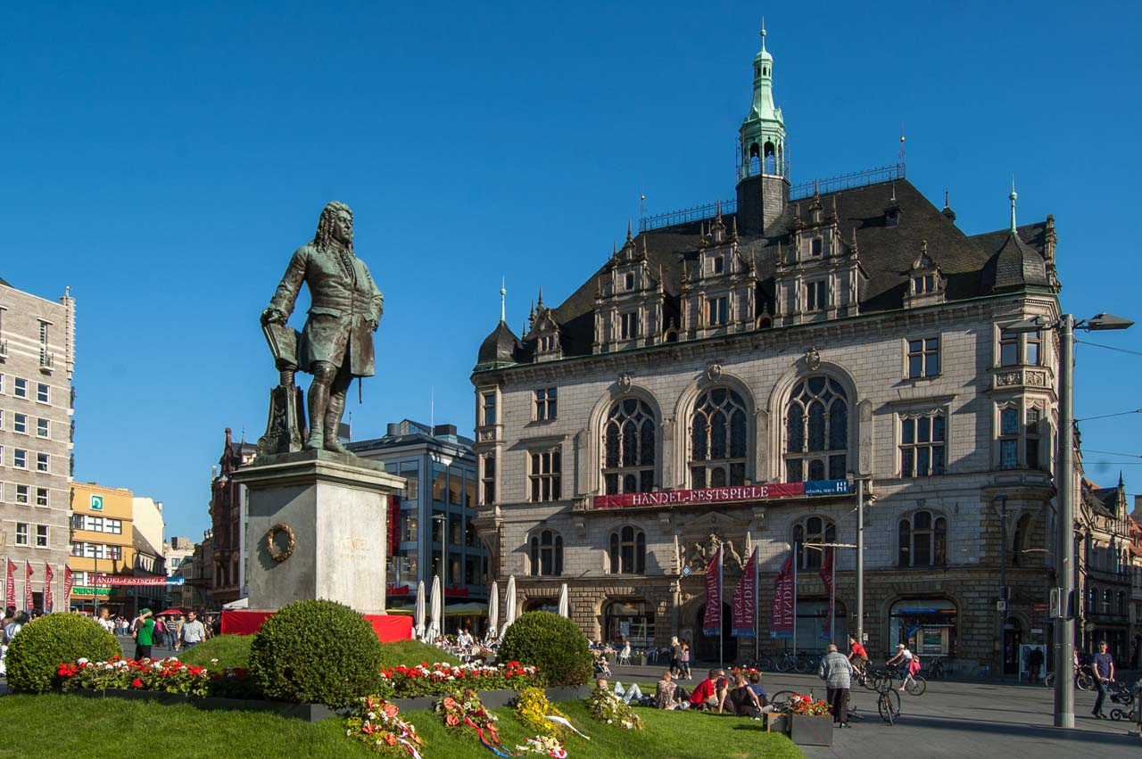
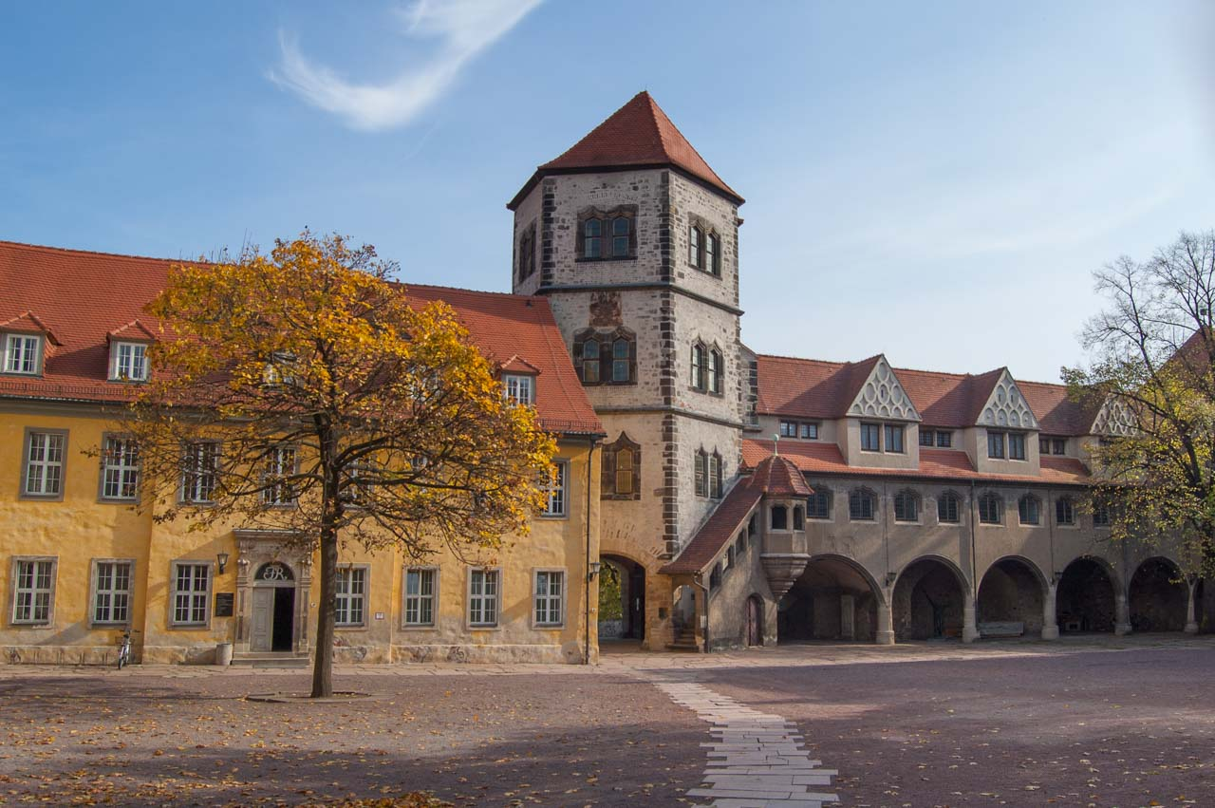
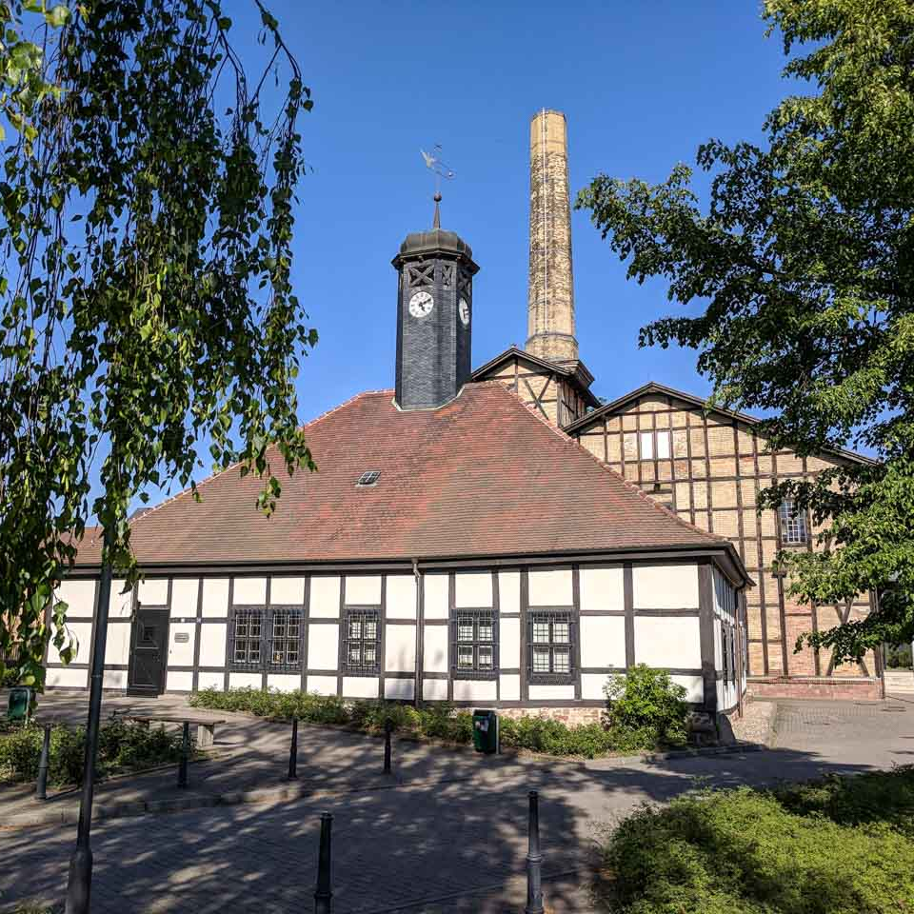
Historic Halle
Market Square with the Handel Monument and Stadthaus
Photo: MLU / Katharina Nitschke
Moritzburg Art Museum
Technical Hallors and Saline Museum Halle (Saale)
Photo: MLU / Katharina Nitschke
Photo: MLU / Katharina Nitschke

Slide 28
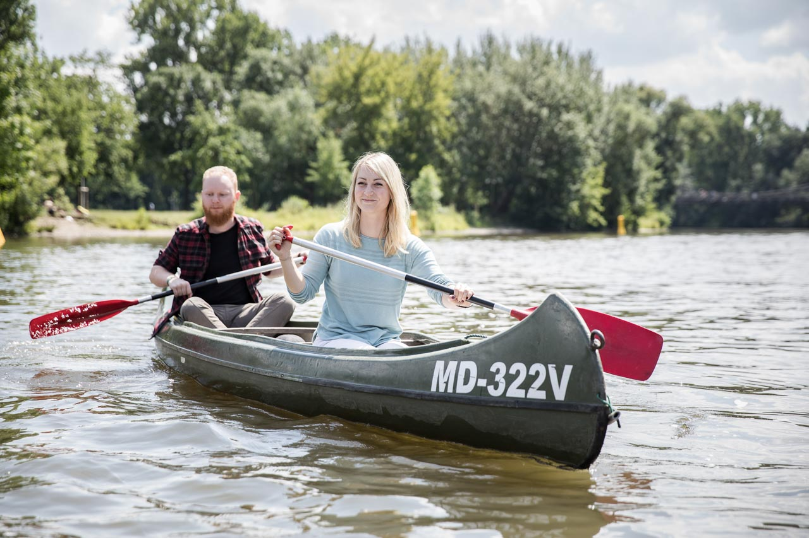
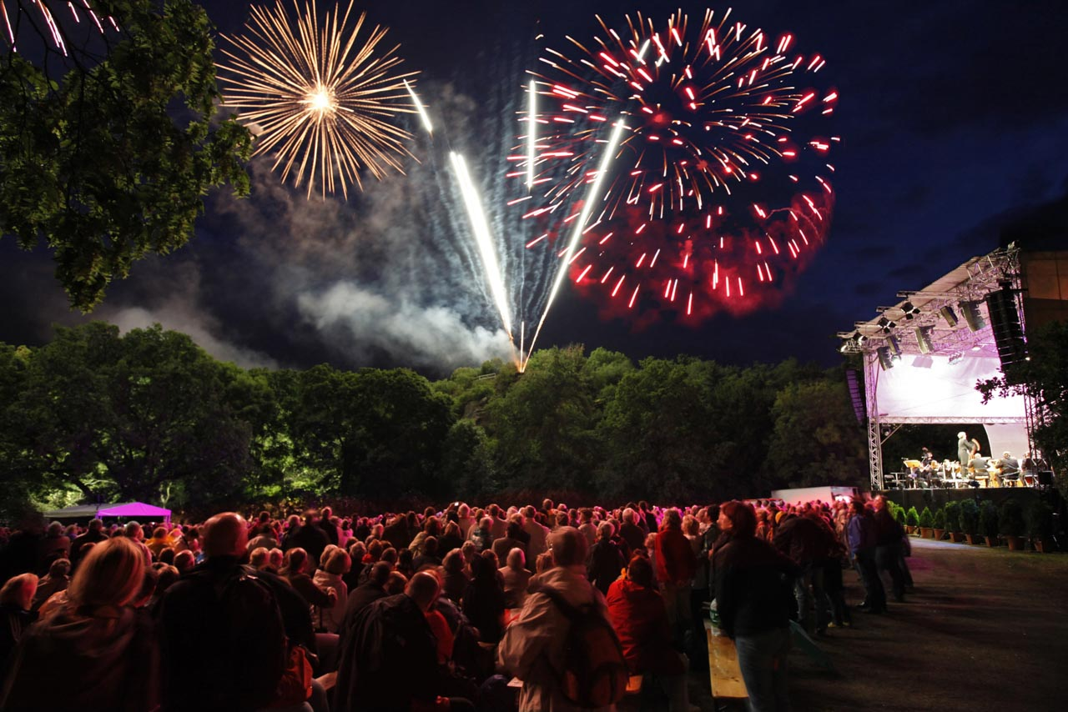
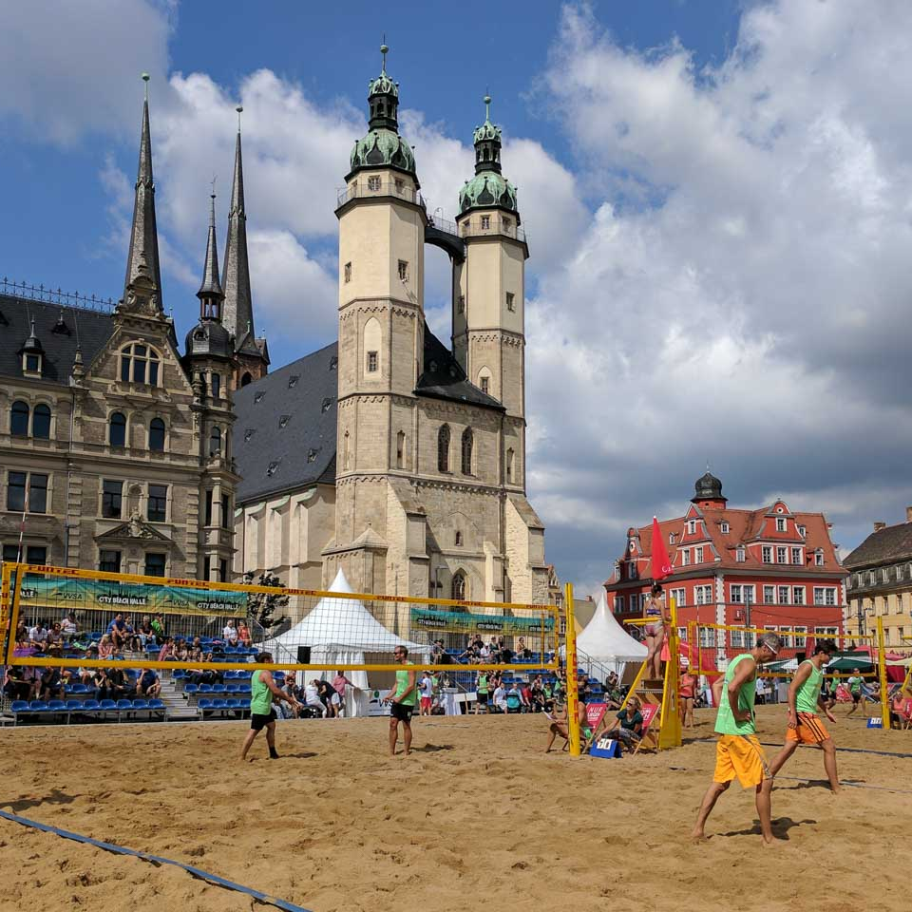
Vibrant Halle
Paddling on the Saale River
Photo: MLU / Matthias Ritzmann
Annual Handel Festival in Halle
Beach volleyball tournament on the Market Square
Photo: Stadt Halle / Thomas Ziegler
Photo: MLU / Katharina Nitschke

Slide 29
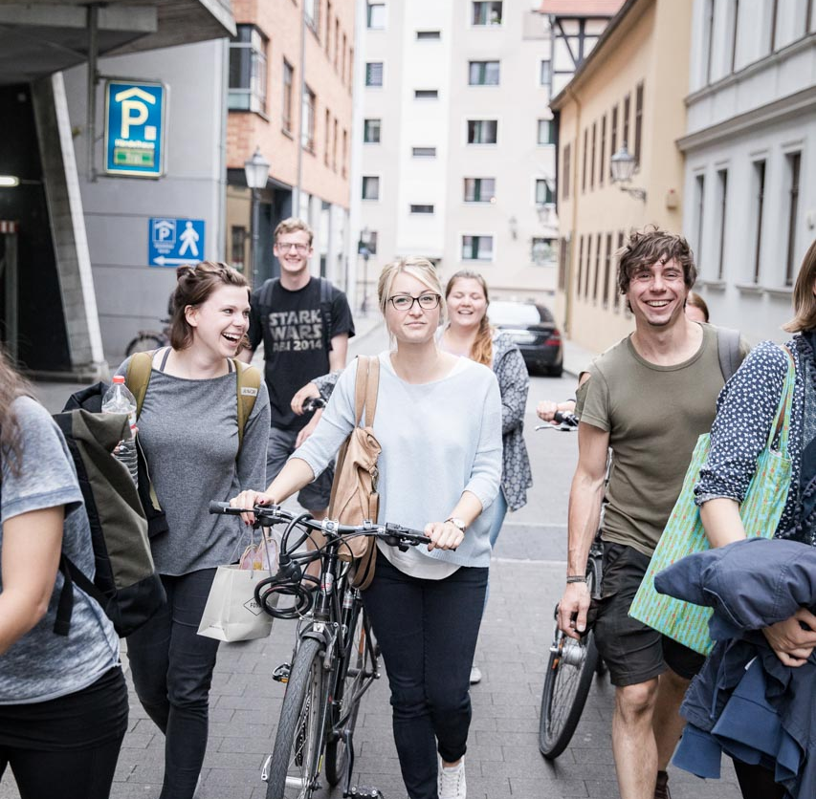
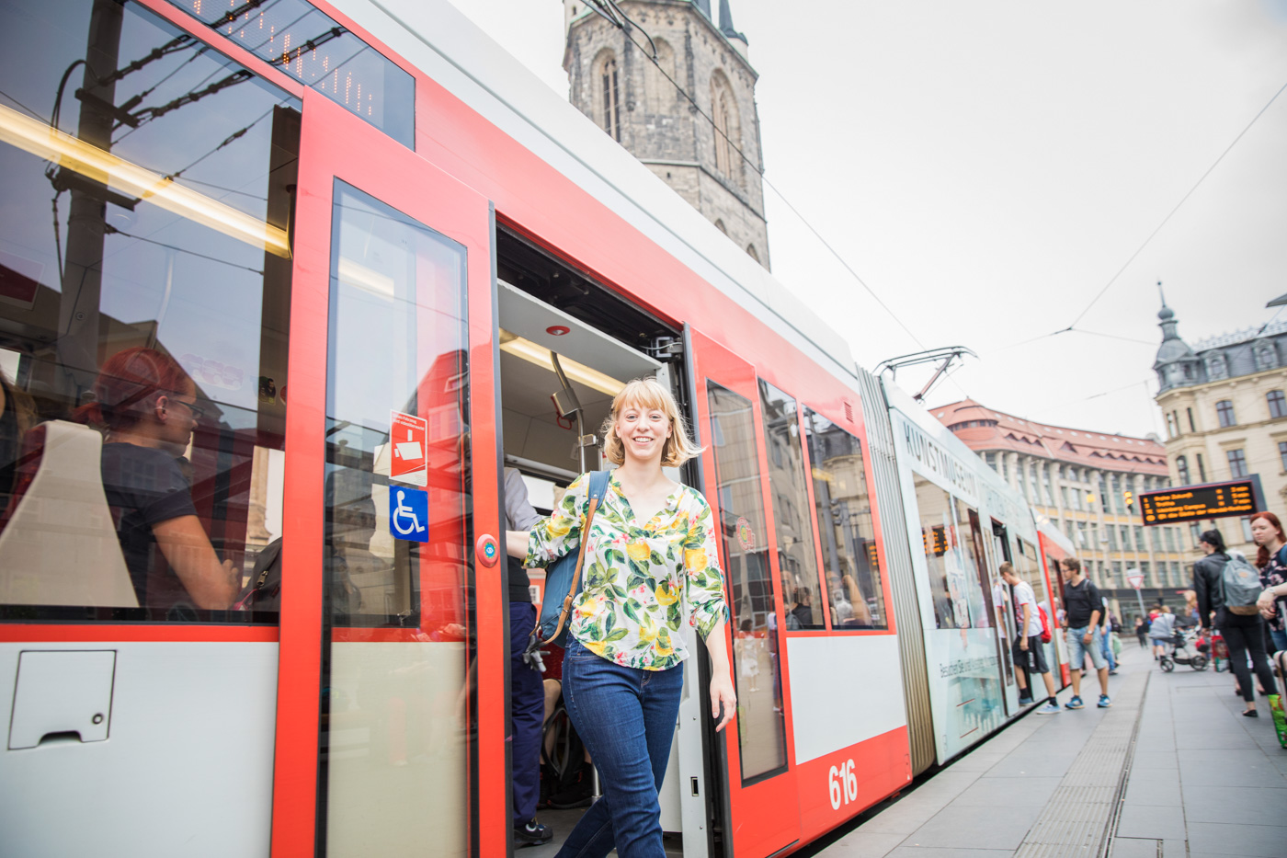
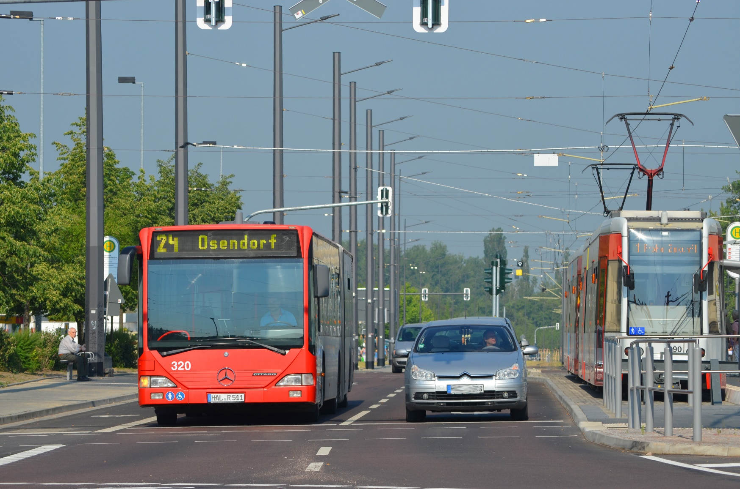
On the go in Halle
On foot or by bicycle
Photo: MLU / Matthias Ritzmann
By tram
By bus or car
Photo: MLU / Matthias Ritzmann
Photo: Stadtwerke Halle GmbH

Slide 30

Charles Tanford Protein Centre
Photo: MLU / Maike Glöckner

Slide 31

Daily lectures take place in the lecture halls of the Löwengebäude and countless events are held in the Auditorium.
Photo: MLU / Maike Glöckner

Slide 32

Weinberg Campus (Heide Süd area)
Photo: MLU / Maike Glöckner

Slide 33

Audimax on University Square
Photo: MLU / Maike Glöckner

Slide 34

Tropical House at the Botanical Garden
Photo: MLU / Maike Glöckner

Slide 35

Researching into a new vaccine at the state-of-the-art Charles Tanford Protein Centre
Photo: MLU / Maike Glöckner

Slide 36

Hands-on education
Photo: MLU / Matthias Ritzmann

Slide 37

Eating well in the Studentenwerk cafeterias
Photo: MLU / Matthias Ritzmann

Slide 38

Internationalisation at Martin Luther University Halle-Wittenberg
over 300 partnerships with universities and research institutes around the world
2,000 international students
500 international PhD students
Several courses of study taught partially in English
3 courses of study entirely in English:
Business Economics (BA)
Pharmaceutical and Industrial Biotechnology (MA)
Polymer Materials Science (MA)
Photo: MLU / Michael Deutsch
Photo: MLU / Markus Scholz

Slide 39

International Courses of Study
Bachelor programmes
Business Economics (B.Sc.)
Engineering Management (B.Sc., in planning)
Master programmes
Business Law and Economic Law (LL. M. oec.)
Forms of Rationality / Forme della razionalità (M.Sc.)
Pharmaceutical and Industrial Biotechnology (M.Sc.)
No tuition fees (however 8,000 € p.a. are to be paid into a blocked account)
Semester fee (approx. 200 € per semester)
Photo: MLU / Markus Scholz

Slide 40


International Office – Support For:
International students
Orientation week
Buddy programme
Language courses
Support in finding a flat, insurance, visa
International PhD students and scientists
Support in finding a flat, insurance, visa
Accommodation in the Georg Forster International Guesthouse
Language courses, including for family members
Excursions, Christmas party, meet-ups, newsletter
Scholarship advice
Advice on scholarships available in Germany
Photo: MLU / Markus Scholz
Photo: MLU / Katharina Nitschke

Slide 41

Imprint
Martin Luther University Halle-Wittenberg
Rector’s Office – “Central Communications” and “University Marketing and Event Management”
06099 Halle (Saale)
www.uni-halle.de
pr@uni-halle.de
Photo: MLU / Katharina Nitschke

